Slide 1
Copyright & Fair Use:
What does it mean for broadcasts?
Tabitha Edmondson-Goodman
Multimedia & Web Design

Slide 2
What does Copyright mean?
Copyright is considered protection by the United States law under Title 17 of the US Code, to authors who create fixed works. Fixed works can include:
Books
Recordings
Movies
Computer programs
Architectural works
It is important to remember that this protection is available to both published and unpublished works.
Notes:
Have you ever seen this image before? Well this image means that the work is a fixed work. Fixed works can be musical, written, artistic, or even performed.

Slide 3
What is Fair Use?
In section 107, Title 17 of the US Code, Fair Use exempts educators, reporters, and critics from certain copyright restrictions.
This allows others to use parts of the copyrighted work for:
News reporting
Commentary
Teaching
Research

Slide 4
Fair Use or Copyright Infringement?
There are four factors to determine if something is Fair Use or Copyright Infringement:
The purpose and character of the use- Will it be used for commercial use or for educational purposes?
The nature of the copyrighted work
The amount of the copyrighted work used
The effect of using the material will have on its value

Slide 5
What does this mean for Educators?
Schools cannot:
Use photocopying as a way of not paying for books, charts and music or purchasing a whole collection.
Use photocopies that are considered fair use for the same class year after year.
Use movies for entertainment purposes unless they qualify under not-for-profit exemptions.
Make copies of copyrighted music, even when the music is the effort of the teacher who does the copying.

Slide 6
What does this mean for Educators?
Schools can:
Photocopy excerpts from copyrighted material. For example, you can make a single copy of a chapter from a book, or an article from a newspaper.
Perform copyrighted literary or musical works in the classroom setting and for non-profit program. This does not include dramatic works however.

Slide 7
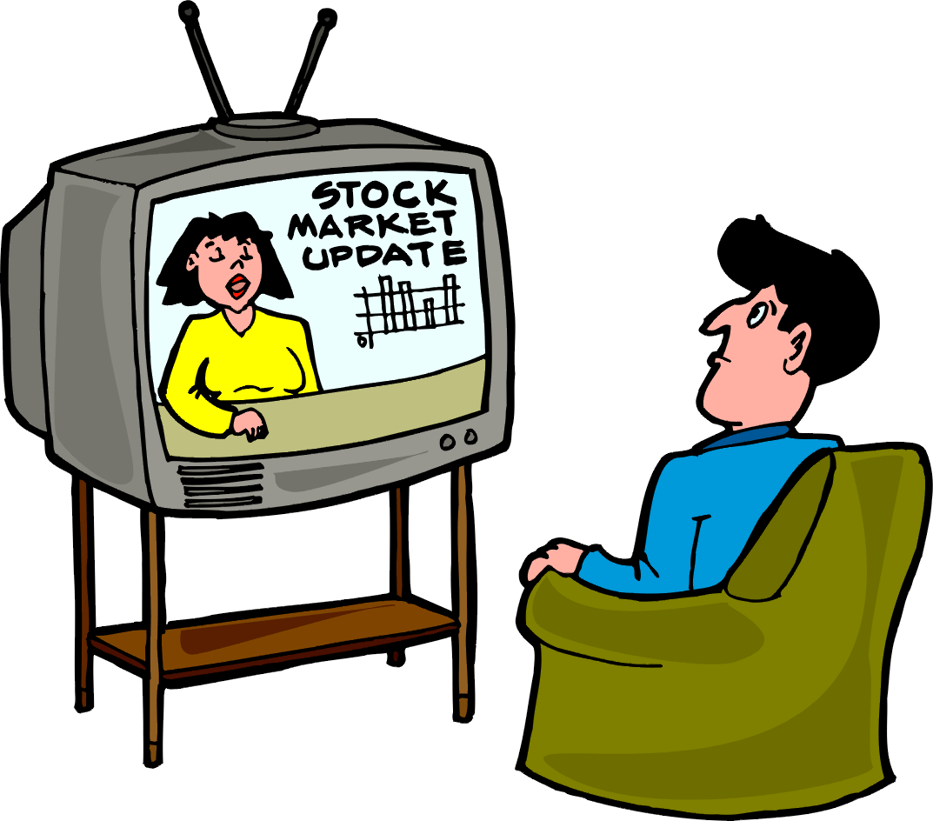
What does this mean for broadcasts?
Educators can use broadcasts or videotapes from local stations and cable shows. For example:
ABC, NBC, CBS, UPN, and PBS (Local stations)
CNN, MTV, and HBO (Cable shows)

Slide 8
What does this mean for broadcasts?
Educators can use these broadcasts or videotapes for classroom instruction.
Schools can keep these tapes for a minimum of ten school days.
The cable shows can be used, but permission must be granted.

Slide 9
How do I get permission?
Identify the owner.
Identify the rights needed.
Contact the owner and determine if a payment is needed.
You will need to get their permission in writing.
Notes:
1. Identify the owner. Sometimes it’s simple as looking at the copyright notice for their name.
2. Identify the rights needed. How will you be using the material? Will you be reproducing, distributing, or modifying the work?
3. Contact the owner and decide if you will need to pay for their material.
4. Always get their permission in writing explaining how you will be using the materials and their agreement.

Slide 10
Test your knowledge!

Slide 11
Copyright Infringement or Fair Use?
Mr. Sanders, your history teacher, taped the Challenger disaster in 1986. He taped the broadcast at home on his VCR. He planned to share this broadcast with his AP history class. Is this covered under fair use or is it copyright infringement?
Notes:
Answer: The answer is copyright infringement. Congress holds that videotapes of publicly broadcast shows and it can only be shown for 10 days afterward unless the copyright holder grants allowances for teachers.

Slide 12
Copyright Infringement or Fair Use?
One of the paraprofessionals is in charge of the Good Behavior Club. Students are allowed to come to this room when they exhibit positive behavior throughout the week. This week she decides to rent Frozen from Redbox to reward the students. Is this considered Fair Use or Copyright Infringement?
Notes:
Answer: Copyright Infringement.
Using videos for entertainment and rewards are excluded under the copyright guidelines. To show the movie she would need to find a version from an authorized distributor who can license her to show it.

Slide 13
Copyright Infringement or Fair Use?
Dr. Oz has a great show scheduled tomorrow on teenage health and hygiene. Our school PE teacher wants to show it to her classes. She contacts the local television station, but they denied her permission to show it because it is a violation of the copyright law. Can they do this?
Notes:
Answer: No, the television station is wrong. They do not hold the copyright on Dr. Oz’s show and the use would occur within 10 school days after the broadcast.

Slide 14
Need more information?
Do you still have questions about copyright and fair use? Please visit the U.S. Copyright Office at: http://www.copyright.gov

Slide 15
References:
United States Copyright Office. Reproduction of copyrighted works by educators and librarians. Retrieved June 24, 2006 from Circular 21 at http://www.copyright.gov/circs/cir21.pdf
Lyons, M. (2010). Open Access is Almost Here: Navigating through copyright, fair use, and the teach act. The Journal of Continuing Education in Nursing, 41(2), 57-64.

