Slide 1
CRCT Data Overview for A. L. Burruss Elementary
T. Edmondson-Goodman
Data Analysis & School Improvement
ITEC 7305

Slide 2
Data Overview
Purpose & Goal
Demographics
A. L. Burruss and MCS District
CRCT Results- Mathematics
Comparing ALB & District
Subgroups
Strengths & Weaknesses
Tasks for Faculty

Slide 3
Purpose & Goal
To provide an overview of the students performance at A. L. Burruss in comparison to the district using the available Math CRCT data.
While comparing the longitudinal Math CRCT data from 2011-12, 2012-13, and 2013-14, we will be looking for strengths, weaknesses, and possible trends in student achievement.

Slide 4
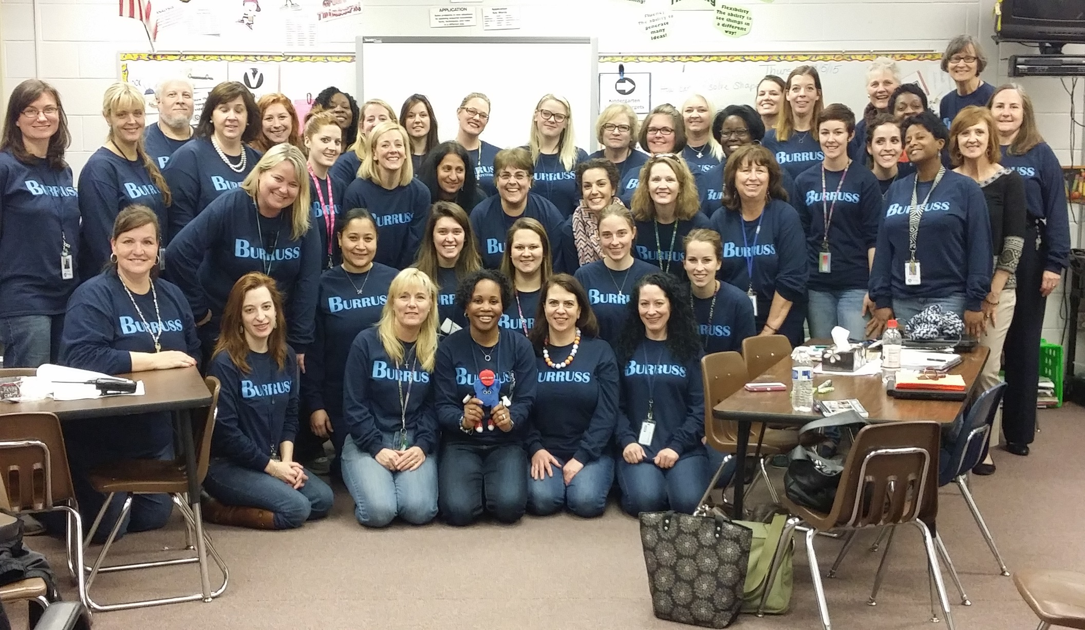
Welcome to A. L. Burruss

Slide 5
Our Students
Notes:
Total Enrollment:
2011-12: 516 students
2012-13: 531 students
2013-14: 541 students

Slide 6
Our Students

Slide 7
Our Students

Slide 12
ALB & MCS Comparison
Mathematics CRCT Results
2011-2014

Slide 13
Notes:
During the 2011-12 school year 54 students were tested. In the 2012-13 school year 35 students were tested and during the 2013-14 school year 67 students were tested. When comparing it the MCS student body, during the 2011-12 school year 633 students were tested. During the 2012-13 school year 681 students were tested and then 707 fourth graders were tested in 2013-14 school year.

Slide 14
Notes:
Race/Ethnicity:
2011-12: 21 African-American students and White students were tested.
2012-13: 25 African American students were tested. The state did not provide how many White students were tested.
2013-14: 33 African-American students and 25 White students were tested.

Slide 15
Notes:
Economically Disadvantaged:
2011-12: 26 Economically Disadvantaged students were identified and 28 Non-Economically Disadvantaged students were tested.
2012-13: 27 Economically Disadvantaged students were tested. The state did not provide how many Non-Economically Disadvantaged students were tested.
2013-14: 41 Economically Disadvantaged students and 26 Non-Economically Disadvantaged students were tested.

Slide 16
Notes:
ELL & SWD:
2011-12: 4 SWD and ELL students were identified and tested.
2012-13: 5 SWD students were tested. 8 ELL students were tested.
2013-14: 8 SWD students and 7 ELL students were tested.

Slide 17
Strengths
The percentage of students at the DNM level decreased by 14% between the 2011-12 and 2012-13 school year from 17% to 3%.
The percentage of students at Level 2 increased by 18.5% from 2011-12 to 2012-13 from 44.4% to 62.9%.
The percentage of students at Level 3 increased by 7.5% between 2012-13 to 2013-14 from 34.3% to 41.8%.
Our ALB 4th grade students, who scored a Level 2 during the 2012-13 school year, outscored the District 4th graders by 16.2%.
15.4% our ELL population DNM, but the following school year only 2.9% of our ELL students DNM their CRCT requirements. This is a decrease of 12.5%.

Slide 18
Weaknesses
In 2011-12 30.8% of our students identified as Economically Disadvantaged scored a Level 1 or DNM criteria on the CRCT Math.
In 2011-12 23.8% of our African-American students scored a Level 1 or DNM criteria on the CRCT Math.
In 2013-14 there was a 29.7% achievement gap between our African-American and White students who scored a Level 3 or Exceeds.
In 2011-12 and 2013-14 17% and 14.9% of our students scored a Level 1 or DNM.

Slide 19
Task for the Faculty:
Our highest percentage of students in the Exceeds category on the Math CRCT was during the 2013-14 school year. What caused this and how can we ensure that we do the same or better this year?
During the 2011-12 and 2013-14 school year our Economically Disadvantaged students scored the highest in the DNM category. During the 2012-13 school year the ED students dropped from 30.8% to 3.7% and then back to 19.5% the following year. What caused the drastic drop during the 2012-13 school year and why did the numbers increase the next year?
Our ELL and SWD have made great gains during the 2012-13 school year. They both have over 60% scoring a Level 2. How can we move these students from a Level 2 to a Level 3?
Where do we go from here?

Slide 20
Questions?

